Slide 1
Bridging the Gap: How do we get from 1980’s education to STEM?
West High School Feeder Professional Development
Wednesday, December 12, 2012
8:00am-3:30pm
Welcome
and
Introductions

Slide 2
- BE a Present Participant - BE Respectful of Yourself & Others - BE a Positive and Creative Thinker! *Attention Signal
“BE” Attitudes

Slide 3
By the End of Today
Leave here with a clear, simple plan for organizing and documenting your teaching standards.
“Make and Take” a STEM unit to teach with your team.
Announce our WINNERS!

Slide 4
Group Activity – Who are our students?
8:45-9:00
Each person shares by adding their lesson to the chart and describing the lesson using the information from the “Look to the Evidence” activity.
9:00-9:15
Each group chooses one lesson from their table that was the most unique for some reason and that person will share with the room.

Slide 5
Organizing & Documenting Standards
Handout:
“Organizing and Documenting Standards”
Math Grade Level Common Core Standards Chart
ELA Grade Level Common Core Standards Chart
Science and Social Studies Grid for Elementary
Click to open “Organizing and Documenting Standards”

Slide 6
Organizing &
Documenting Standards
STEP 2
STEP 4 TODAY Section Only
If you have time… Begin STEP 3 #2
Suggestion:
Split up at your table and then share work.
Support Staff, PE and Fine Arts Teachers:
It’s important for you to be familiar with the Common Core standards so you can support the Core Curriculum with your work as well.
BREAK AS NEEDED
Finish/Return by 10:30

Slide 7
Make & Take STEM Unit
Handout:
“STEM Planning Framework”
Access www.MrsEffron.com
Leave the confines of Columbus for today.
In a utopian world what lessons would you create?
Step away from what Columbus asks of you and be inspired.
Click to open “STEM Planning Framework”

Slide 8
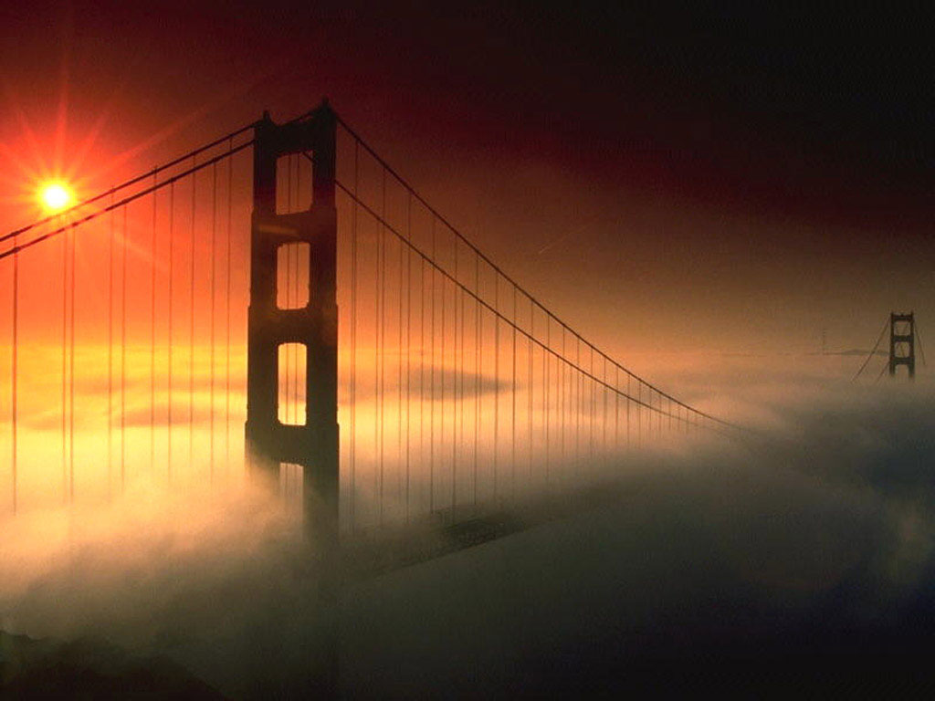
The Planning of
The Bridge Challenge

Slide 9
Stage 1:
Standards Chart
Enough said.
The Planning of
The Bridge Challenge
I didn’t have the standards
charts created yet so I used
the Curriculum Guides.
Oh - the horror!

Slide 10
Stage 2: Create a Driving Question
→Choose a STEM Challenge
Using Science and Social Studies standards, choose Problem Based Challenges.
Can be small (grading period, a month, or just two weeks)
Do not try to integrate other standards at this time.
Ideas: Problem Based Ideas
THEN - Choose - most exciting and spurs the most curricular connections from your team.
YOU MUST – Turn the challenge into a DRIVING QUESTION. The students should be solving a problem, not just following the steps to create a product or complete a model/science experiment.
The Planning of The Bridge Challenge
How will your team build the most cost effective bridge that meets specific height and strength requirements?

Slide 11
Stage 3: Brainstorm Curriculum Connections
→Align Core Subjects, Fine Arts, World Language, and Technical Subjects
Curriculum
Create a Curricular Connection Web
Think Outside the Box!
Do NOT eliminate any ideas yet.
Use your Standards Charts to reference standards that still need to be addressed.
How can you CREATIVELY make connections to your Driving Question or Final Product?
The Planning of The Bridge Challenge
I created the connection web on the next page

Slide 12
ELA Presentation Speech Journal Response Non-Fiction Reading Skills Fictional Reading Skills Grammar Skills Vocabulary Skills | Math Cost Effective (Money) Measurement (Length/Width) Metric Conversions Geometry Graphing Data Charting Data
Science Engineering Disasters Water Flow/Speed Dams, Hydropower and Other Green Energy Water cycle | Social Studies Famous Bridges City History Maps and Geography Travel, Getting from Place to Place Natural Resources Trade War (Importance)

Slide 13
Stage 4: Choose Lessons & Standards
→Make decisions about which activities, products, projects,
and standards you want to address.
Choose at least one product that integrates all subject areas and will have a COMMON RUBRIC.
Pick a few standards that you can focus on and teach deeply rather than several you can touch on.
Select products that are engaging and will show learning of each standard.
The Planning of The Bridge Challenge
Math: Measurement, Money
ELA: Speech, Non-Fiction Background
Science: Engineering, Dams (Hydropower Energy)
Social Studies: Maps, Geography, Getting From Place to Place

Slide 14
Stage 5: Design a Timeline
→This step usually happens concurrently with Step 4 and is
often modified along the way.
Create a large calendar for the unit.
Write each activity or core standard on a post-it note.
Move the “notes” around until they work together to create a cohesive unit.
Monday | Tuesday | Wednesday | Thursday | Friday
Monday | Tuesday | Wednesday | Thursday | Friday

Slide 15
Stage 6: Build Rubrics and Lessons
→Write Interdisciplinary Problem Based Lessons and Create Rubrics.
Each individual lesson or activity needs a relevant question to guide instruction that relates to the end challenge or the student’s lives.
Turn “I Can” Statements into relevant questions.
The Planning of The Bridge Challenge
Lessons and products leading up to the bridge unit

Slide 16
Examples of lessons and products in the STEM Unit leading up to the Bridge Construction project.
Standard | Question | Product
Measuring length and width in centimeters using a standard ruler. (Math) | How can we use rulers to measure in centimeters so we’ll be able to create the correct length and width of the work board and bridge that meet the requirements for our bridge construction? | Chart that compares the length and width of 10 or more items found in the classroom that were measured with the ruler.
Describe push/pull factors that relate to people settling in certain areas. (SS) | How could a bridge impact a person’s choice for settling in a specific place? | On a map, create three routes to new homes – one each that crosses the Scioto River, the Ohio River and the Mississippi River.

Slide 17
Rubrics
The students ALWAYS need to be given the rubric before beginning the assignment.
As a team, create a rubric for teachers and students BEFORE starting any integrated project. (OUR BRIDGE RUBRIC)
A portion of an integrated project that is completed in one subject could be graded before becoming part of the larger “team” project. It would require a separate rubric.
Every mini product or assignment needs a rubric or clear expectations before being developed. (These are the small lessons in a unit that are taught leading up to the final challenge.)
The more clear and simple the rubric is, the easier the projects can be assessed.
Students can assess each other and themselves.

Slide 18
Welcome back from Lunch
To prepare for our next activity, please:
Log on to the internet.
Have your Standards Charts and Science and Social Studies Standards ready.
Find the Handout: “STEM Planning Framework” that we reviewed before lunch.

Slide 19
(12:30-1:45)
Make & Take STEM Unit
PART 1: After Lunch
Step 2-3
Create a Driving Question (Challenge) and
Brainstorm Curriculum Connections
 www.MrsEffron.com
Use these problem based activities – or ideas of your own – as places to start developing your challenges.
Remember: You need to turn these into Driving Questions.
Use your standard charts to brainstorm a web.
Keep an OPEN mind.
Think Big – don’t make eliminations.
Write it ALL down.

Slide 20
(1:45-3:00)
Make & Take STEM Unit
PART 2:
Step 4-5
Choose Lessons & Standards and
Design a Timeline
Think about “How do we measure our academic impact?”
as we complete this activity.
Remember to make at least ONE integrated product.
Keep your timeline in mind when choosing the amount of standards and lessons you want to include.
Go DEEP not WIDE.
Develop relevant questions for the lessons (“I Can statements”).

Slide 21
Wrap-Up
(3:00-3:30)
The Great Project Share
Addressing the Parking Lot
Q&A

Slide 22
HOMEWORK
Bring back evidence of your STEM work:
Pictures!
Movies!
Products!
Your CCIT’s are a Resource!
CCIT’s can co-teach!

